Slide 1




Critical Thinking S1 2023
Tutor: Dr. Iwan Williams
Email: iwan.williams1@monash.edu

Slide 2
Lecture 9.1.
Normative Arguments

Slide 3
Review quiz!

Slide 4
What is a normative argument?
An argument with a normative claim as the conclusion.

Slide 5
Descriptive Claims
Normative Claims
… are claims about what is the case.
The kitchen is dirty.
Smoking causes cancer.
War always results in the death of innocent people.
Billy always gets to ride in the front seat.
… are claims about what should be the case.
I should clean the kitchen.
You shouldn’t smoke.
War is never permissible.
That’s unfair.
Notes:
Very important distinction!
Normative claims:
what we ought to do
what is permissible or impermissible
what is right or wrong
what is good or bad

Slide 6

Is this normative argument valid?
P1. Drink driving puts yourself and others at serious risk.
Therefore,
C. You should not drink and drive.

Slide 7
No Ought from Is
P1. Drink driving puts yourself and others at serious risk.
A2. You should not do things which put yourself and others at serious risk.
Therefore,
C. You should not drink and drive.
Notes:
David Hume.
People often fail to explicitly state their normative assumptions.
The key thing to note here is that normative arguments must include their normative premises so that they can be evaluated.

Slide 8
Isn’t it just a matter of opinion?
There are sceptical views with regards to normative claims.
However, if normative claims were the same as opinions, then (for instance) claims about the fundamental human rights of women would not differ from an opinion about peanut butter.
But, even if normative claims were somehow reducible to matters of opinion, this does not absolve them from scrutiny! We can have good and bad reasons for our opinions!
Notes:
Relativist antirealism position – no real objective moral truths.
I want to discourage you to take a relativist position, or to equate normative claims to matters of opinion.
Example, opinions next slide

Slide 9
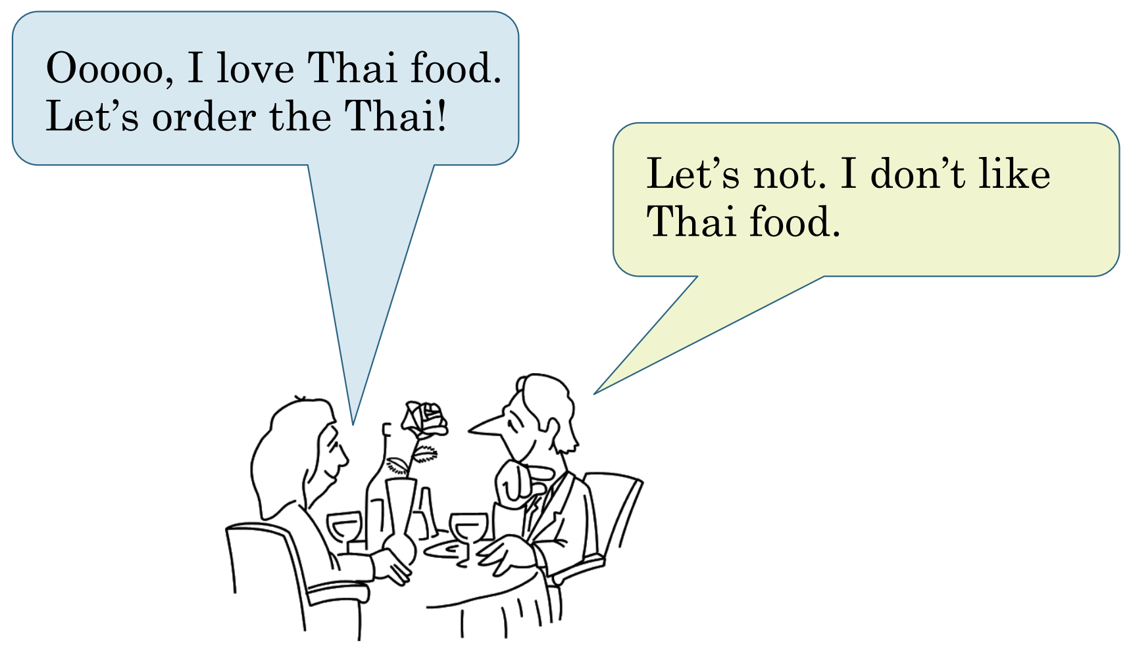
Opinions

Slide 10
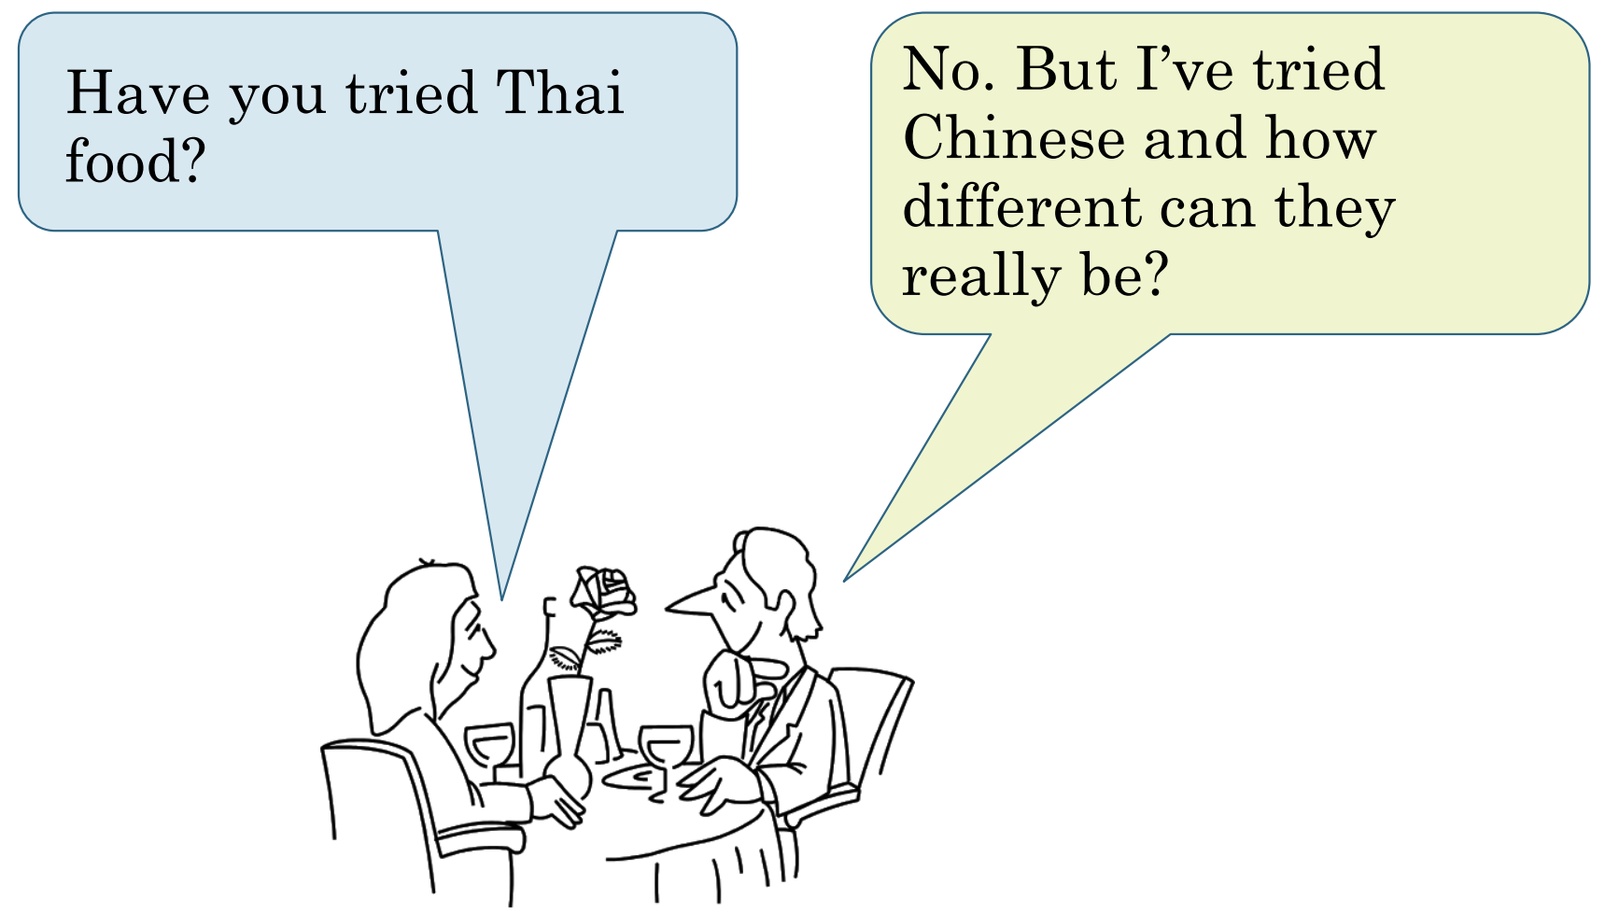

Slide 11
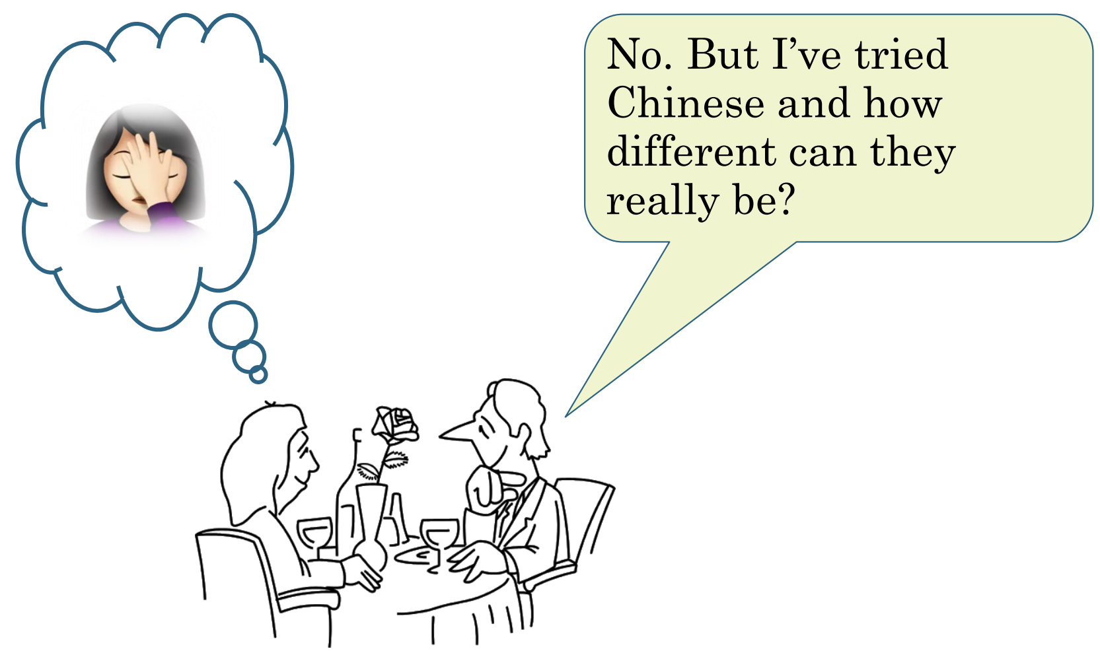

Slide 12
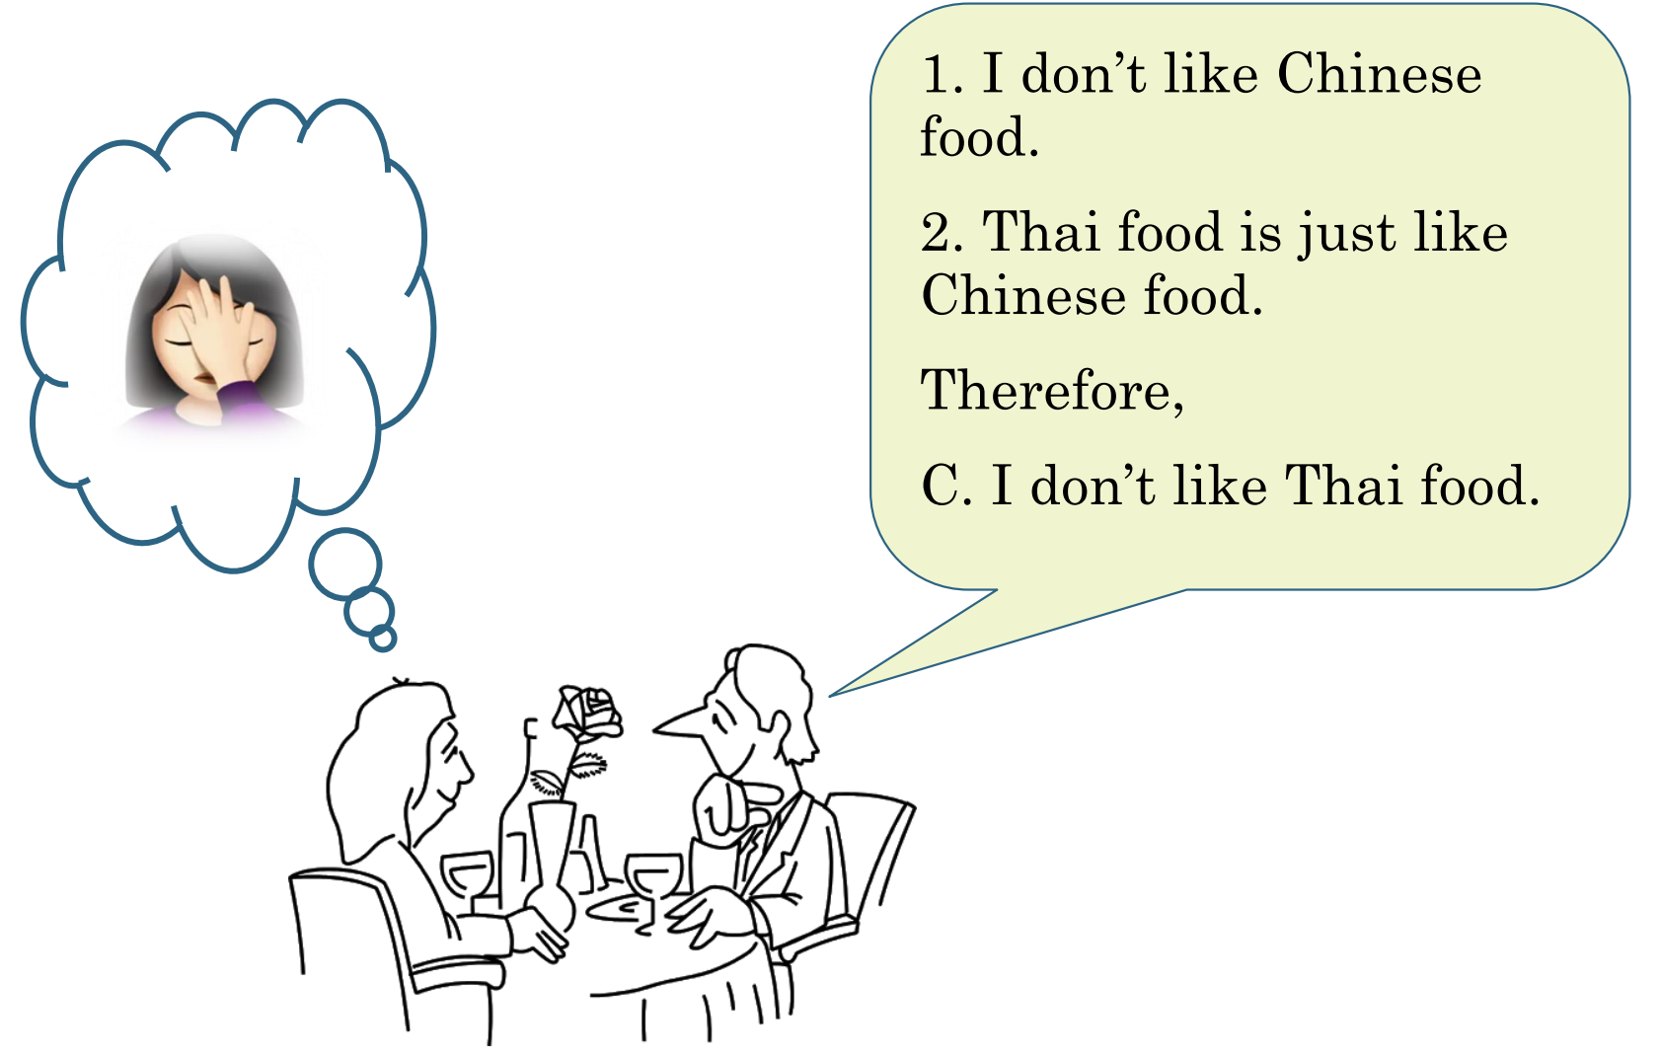
Notes:
So even if normative claims were somehow reducible to matters of opinion, this does not absolve them from scrutiny! We can have good and bad reasons for our opinions!

Slide 13
What about for moral claims?

Slide 14
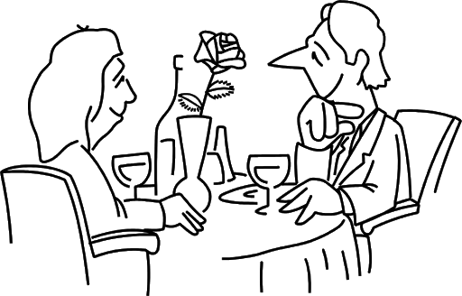

Abortion is permissible.
Abortion is impermissible.

Slide 15
What! How could you possibly think abortion is impermissible?
Because it is! Abortion is impermissible!
Notes:
Are they at an impasse? This debate may start getting difficult due to our inherent tendency to defend our beliefs. We need to try to be open minded: scout minded. Engage in ethical issues in genuinely open manner, and you may have good discussions with people! Ask why and the conversation may go better.
Notice that no one has offered an argument yet.

Slide 16

Solider Mindset
Goal is to show that my beliefs/opinions are the right ones.
New information that challenges something I believe is seen as a threat to be neutralized.
Scout Mindset
Goal is to arrive at more accurate beliefs/opinions.
New information that challenges something I believe is seen as an opportunity to update my beliefs/opinions.

Slide 17
Moral arguments
1. Killing innocent persons is always wrong.
2. Unborn babies are innocent persons.
3. Abortion results in the death of unborn babies.
Therefore,
C. Abortion is impermissible.
Why do you think abortion is impermissible?
Notes:
Now we have an argument to evaluate!
One thing we can do is show that a descriptive premise is false.
Another thing we can do is challenge the underlying moral principle (Premise 1).

Slide 18
1. Killing innocent persons is always wrong.
2. Unborn babies are innocent persons.
3. Abortion results in the death of unborn babies.
Therefore,
C. Abortion is impermissible.
Killing innocent persons is always wrong? Always?
What about in self defense?
What about during war?
What if killing one innocent person will save 100?
Notes:
Remember week 5 - universal generalisations.
Can be shown to be false by finding counterexamples.

Slide 19
1. Killing innocent persons is always wrong, except when …
2. Unborn babies are innocent persons.
3. Abortion results in the death of unborn babies.
Therefore,
C. Abortion is impermissible.
Killing innocent persons is always wrong? Always?
What about in self defense?
What about during war?
What if killing one innocent person will save 100?
Notes:
In a scout-like discussion, this might lead the person to revise their argument.
Another way of evaluating a normative argument is by engaging with descriptive premises

Slide 20
1. Killing innocent persons is always wrong, except when …
2. Unborn babies are innocent persons.
3. Abortion results in the death of unborn babies.
Therefore,
C. Abortion is impermissible.
Are unborn babies really innocent persons in the relevant sense?
They are members of the species Homo Sapiens sure.
But persons are self-conscious, autonomous, rational beings.
Unborn babies are none of these.
Notes:
Gives you a flavour of what normative arguments look like, and how we can engage with them in a scout-like way. Carefully considering reasons, rather than simply digging in favour of a certain view.

Slide 21
Evaluating normative arguments
Like any other argument there are two things to consider when evaluating a normative argument:
Support (If the premises were true, would they provide a good reason to accept the conclusion?)
Are there any unstated normative assumptions in the argument? (You can’t get an ‘ought’ just from an ‘is’)
…?
Truth (Are the premises acceptable as true?)
Evaluate the descriptive premises and the normative premises.
Are the descriptive premises well supported by good evidence? Are the sources credible?
… what about normative premises?

Slide 22

Verifying Descriptive Claims
Suppose you’re trying to figure out whether or not it’s possible in principle to heat a cup of tea just by stirring it really really fast.
You could try it yourself.
You could sit down with pen and paper and think really hard about it.
Or you could just Google it.
https://what-if.xkcd.com/71/
Notes:
D claim – heat up cup of tea by stirring it fast? Google can help us out

Slide 23
Thinking Critically about Normative Claims
Suppose you’re trying to decide whether you should skip class and go to the beach.
Can you could just Google it?
Google can give you descriptive facts – weather, content covered in class – but it can’t tell you whether it would be good for you to skip class or not.

Slide 24
Evaluating Normative Claims
When evaluating a normative claim, you need to consider both the reasons for and the reasons against it.

Slide 25
Should we skip class and go to the beach today?
Reasons for
Reasons against
The weather is perfect beach weather today. It’s probably the last day of warm weather until Spring. We should make the most of it.
We have an exam in class today worth 50%. Failing this unit would be bad!

Slide 26

Should we skip class and go to the beach today?
Reasons against
Reasons for

Slide 27
When evaluating normative claims, beware of one-sided arguments.

Slide 28
Normative arguments are often one-sided.
When building normative arguments we often start with our conclusion and then work backwards.
First we identify what we believe to be good (or what we believe we should do).
Then we think up reasons to defend this belief.

Slide 29
1. Killing innocent persons is always wrong.
2. Unborn babies are innocent persons.
3. Abortion results in the death of unborn babies.
Therefore,
C. Abortion is impermissible.
Notes:
Clearly one sided!!

Slide 30
Solider Mindset
Goal is to show that my beliefs/opinions are the right ones.
New information that challenges something I believe is seen as a threat to be neutralized.
Scout Mindset
Goal is to arrive at more accurate beliefs/opinions.
New information that challenges something I believe is seen as an opportunity to update my beliefs/opinions.

Slide 31
1. Killing innocent persons is always wrong, except when …
2. Unborn babies are innocent persons.
3. Abortion results in the death of unborn babies.
Therefore,
C. Abortion is impermissible.
Are there any good reasons for thinking that abortion is permissible?
Notes:
When we give normative arguments we often start with the conclusion and work backwards.

Slide 32
1. People should not be forced to undergo procedures that are painful and potentially dangerous.
2. Childbirth is both painful and potentially dangerous.
Therefore,
3. People should not be forced to undergo childbirth.
Therefore,
C. Abortion is permissible.
1. Killing innocent persons is always wrong, except when …
2. Unborn babies are innocent persons.
3. Abortion results in the death of unborn babies.
Therefore,
C. Abortion is impermissible.
Notes:
When we give normative arguments we often start with the conclusion and work backwards.

Slide 33
Evaluating normative arguments
Support (If the premises were true, would they provide a good reason to accept the conclusion?)
Are there any unstated normative assumptions in the argument? (You can’t get an ‘ought’ just from an ‘is’)
Have all the relevant considerations, for and against, been considered? (That is, is the argument one-sided)? If not, do other considerations outweigh the ones offered?
Truth (Are the premises acceptable as true?)
Evaluate the descriptive premises and the normative premises.
Are the descriptive premises well supported by good evidence? Are the sources credible?
Can you think of considerations for and against the normative premises?
If the argument relies on normative general principles, can you think of any counter-examples? (Remember universal generalisations!) What further consequences does the principle have? Are those consequences acceptable?
Notes:
Counterexamples. We saw this with the abortion example:
Killing is always wrong:
What about in self defense?
What about during war?
What if killing one innocent person will save 100?

Slide 34
Lesson 6, Exercise 3.4
The speed limit on major highways should not be reduced. Professional drivers spend much more time driving, on average, than do other people and hence they are more competent drivers than less experienced drivers. Therefore, reducing the speed limit would have the undesirable effect of forcing some people who are now both law-abiding and competent drivers to break the law.

Slide 35
C
1. Professional drivers spend much more of their time driving on average, than other people.
Therefore,
2. Professional drivers are more competent drivers than less experienced drivers.
Therefore,
3. Reducing the speed limit would force some people who are now both law-abiding and competent drivers to break the law.
Therefore,
C. The speed limit on major highways should not be reduced.
3
2
1
Notes:
3 to C is invalid: descriptive P, Normative C. We need to ID the ASSUMPTION. Rabbit rule: should, Holding hands: law abiding and comptetnt drivers break law!

Slide 36

This argument is one-sided!
1. Professional drivers spend much more of their time driving on average, than other people.
Therefore,
2. Professional drivers are more competent drivers than less experienced drivers.
Therefore,
3. Reducing the speed limit would force some people who are now both law-abiding and competent drivers to break the law.
A4. We should not force otherwise law-abiding and competent drivers to break the law.
Therefore,
C. The speed limit on major highways should not be reduced.
C
3
A4
2
1

Slide 37
Are there any reasons why we should reduce the speed limit?
1. Professional drivers spend much more of their time driving on average, than other people.
Therefore,
2. Professional drivers are more competent drivers than less experienced drivers.
Therefore,
3. Reducing the speed limit would force some people who are now both law-abiding and competent drivers to break the law.
A4. We should not force otherwise law-abiding and competent drivers to break the law.
Therefore,
C. The speed limit on major highways should not be reduced.
C
3
A4
2
1
Notes:
Reduce speed will save lives! Less crashes, less severe crashes.

Slide 38
Problem 1:
The main argument fails to consider both reasons for and against the normative conclusion it seeks to draw.
If the premises of the main argument are true, then it would provide a reason for thinking that we should not reduce the speed limit on highways.
However, given that this is a normative argument, we also need to consider the strength of the reasons in favour of reducing the speed limit.
For example, it might be that reducing the speed limit will save lives and this, other things considered, is a good thing.
Before we can accept the conclusion as true we would need an argument that shows that the reasons against increasing the speed limit outweigh the reasons for doing so.
Notes:
Notice that this doesn’t simply say “this argument is one-sided”, and leave it there.
Be constructive!! Last sentence.

Slide 39
Why can’t experienced drivers just drive slower?
1. Professional drivers spend much more of their time driving on average, than other people.
Therefore,
2. Professional drivers are more competent drivers than less experienced drivers.
Therefore,
3. Reducing the speed limit would force some people who are now both law-abiding and competent drivers to break the law.
A4. We should not force otherwise law-abiding and competent drivers to break the law.
Therefore,
C. The speed limit on major highways should not be reduced.
C
3
A4
2
1
Notes:
Let’s consider truth! Are the P’s true?
P4 is fine
P3 – requires we evaluate sub-arguments!
P1: okay P2: Seems okay as well! Not main problem – P1 says other ppl, P2 says less experienced drivers. P’s seem true, seems valid. What about P2 to P3? Why can’t expereiced drivers slow down?

Slide 40
They have a choice: either drive slower or break the law.
1. Professional drivers spend much more of their time driving on average, than other people.
Therefore,
2. Professional drivers are more competent drivers than less experienced drivers.
Therefore,
3. Reducing the speed limit would force some people who are now both law-abiding and competent drivers to break the law.
A4. We should not force otherwise law-abiding and competent drivers to break the law.
Therefore,
C. The speed limit on major highways should not be reduced.
C
3
A4
2
1
Notes:
They have a choice: drive slower or break the law! P3 has no good reasons to accept it, we can also say that it is false!

Slide 41
Summary
You can’t get an ought from an is! A valid argument for a normative conclusion must have a normative premise.
But it’s not enough to simply point out that an argument has a missing normative premise!
Identify the normative assumption.
Then consider whether it is plausibly true.
When evaluating normative claims we need to consider both reasons for it and reasons against it.
But it’s not enough to simply point out that an argument is one-sided.
Identify some considerations for the other side.
Then consider whether they outweigh the considerations that have been offered.
Focus on MAIN weaknesses/problems.
Be constructive! Be charitable!
Notes:
Analogy: there’s not much point worrying about a few scratches on your bumper if the engine is blown.

